Slide 1
CS4104
Applied Machine Learning
Lecture No 2
Introduction to Concept learning
Spring 2025
1

Slide 2
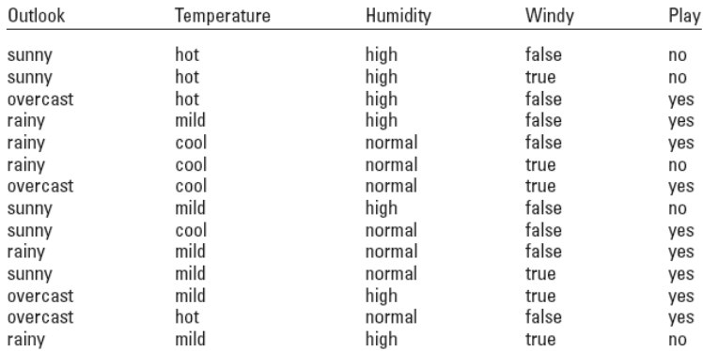
INTRODUCTION
Definition: Examples (Instances)
1

Slide 3
INTRODUCTION
Definition: Attribute
4

Slide 4
INTRODUCTION
Definition: Attribute
Each instance is characterized by its values on a fixed,
predefined set of features or attributes
Attributes are usually the columns of the data table
We will be dealing with data in which the number of
attributes are fixed
The value of an attribute is a measurement of the quantity to
which the attribute refers
5

Slide 5
INTRODUCTION
Definition: Attribute
The attribute values can be numeric or nominal
Numeric Attributes
- Also called continuous attributes
- Are either real or integer valued
Nominal Attributes
- Also called categorical, enumerated, or discrete
- The values are from a pre-specified finite set of
possibilities
6

Slide 6
INTRODUCTION
Definition: Attribute
Nominal Quantities
- The values are just labels or names (symbols).
Hence, they are called nominal (Latin for name)
- No relationship or ordering is implied between these
values (example: sunny, overcast, rainy)
Ordinal Quantities
- They have values which are possible to rank order
(example: hot, mild, cool)
7

Slide 7
INTRODUCTION
Definition: Attribute
Interval Quantities
- They have values that are not only ordered but also
measured in fixed and equal units (examples:
temperature in degrees, dates)
Ratio Quantities
- They are measured from some point of reference
(example: distance of one object from another)
8

Slide 8
INTRODUCTION
Definition: Concepts
9

Slide 9
INTRODUCTION
Definition: Concepts
The thing to be learned is called the concept and the output
produced by a learning scheme the concept description
Example:
Weather Data: The problem is to learn how to classify
new days as Play or Don’t Play
Contact Lens Data: The problem is to learn how to
decide on a lens recommendation for a new patient
10

Slide 10
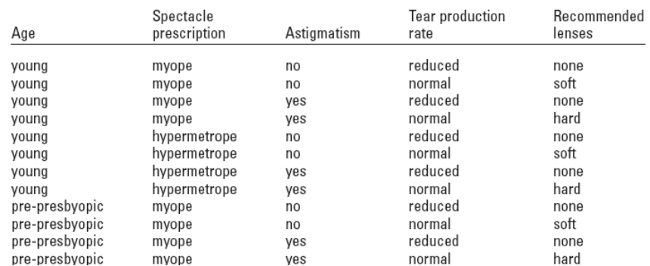
INTRODUCTION
Definition: Concepts
11

Slide 11
INTRODUCTION
Definition: Types of Learning
There are four different learning styles:
Classification
Association
Clustering
Numeric Prediction
12

Slide 12
INTRODUCTION
Classification:
- We have a set of examples with class labels
- We expect to learn a way of classifying unseen
examples
- Example:
If Temperature = Mild & Outlook = Sunny
then Class = Play Tennis
- The learning is usually “Supervised”
13

Slide 13
INTRODUCTION
Association
- Any association among features is sought, not just
ones that predict a particular class value
- Examples: If Bread and Eggs then Butter
If Tea then Milk and Sugar
- The learning is “Unsupervised”
14

Slide 14
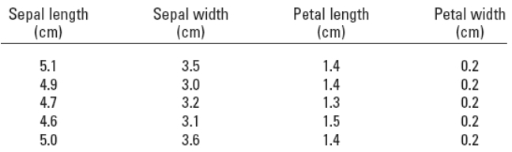
INTRODUCTION
Clustering
- The examples that are similar are grouped together
- The learning is “Unsupervised”
15

Slide 15
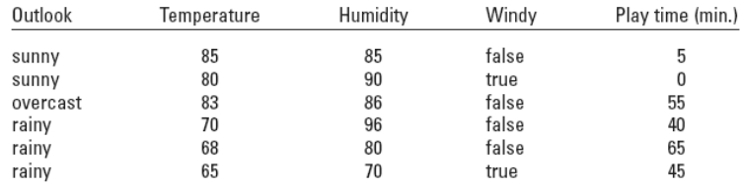
INTRODUCTION
Numeric Prediction
- The outcome to be predicted is not a discrete class
but a numeric quantity
- The learning is usually “Supervised”
16

Slide 16
INTRODUCTION
Useful Reading
2 nd Chapter of Witten & Frank (except 2.4)
17

